Slide 1
The Respiratory Compromise Institute
CHEST 2017
Toronto, Canada
Notes:
maieutic

Slide 2
Disclosures
Consultant Medtronic / Covidien: Jeffery S Vender, MD, MCCM, FCCP

Slide 3
Welcome & Overview Gerry Criner, MD
History & Recent Activities Phillip Porte, RCI Executive Director
Medicare Data Mining James Lamberti, MD
Sidney Braman, MD
Future Research – Surgical Jeff Vender, MD
Future Research – Medical Neil MacIntyre, MD

Slide 4
History & Recent Activities
Subsequent to January 2015 multi society conference examining respiratory compromise, NAMDRC Board of Directors applies for grant.
Grant provided late summer 2015
RCI established as 501(c)(3) tax exempt entity
Responsibility shifted from NAMDRC to separate Board of Directors
Support now comes from grants from Medtronic, Philips, Masimo, Sunovion

Slide 5
Respiratory Compromise is a state in which there is a high likelihood of decompensation into respiratory insufficiency, respiratory failure or death, but in which specific interventions (enhanced monitoring and/or therapies) might prevent or mitigate decompensation.

Slide 6
All clinical matters overseen by Clinical Advisory Committee
Society representatives from broad cross section: CHEST/ACCP, NAMDRC, ATS, ASA, SCCM, SHM, ACEP, NAEMS, NACNS, NBRC, SASM, PPAHS, AARC/Canadian Society of RTs
Physicians who have signaled interest in our research and educational goals

Slide 7
Higher mortality of STEMI identified after hospitalization
Retrospective observational analysis of STEMIs occurring 2008-2013 in California State Inpatient Database
5% of STEMIs occurred in patients who developed STEMI after hospitalization for condition other than Acute Coronary Syndrome (ACS)
Patients with inpatient-onset STEMI higher mortality:
33.6% versus 9.2%
Kaul P, Federspiel JJ, Dai X, Stearns SC, Smith SC, Yeung M, Beyhaghi H, Zhou L, Stouffer GA. Association of Inpatient vs Outpatient Onset of ST-Elevation Myocardial Infarction With Treatment and Clinical Outcomes. JAMA. 2014;312(19):1999–2007.

Slide 8
Hypothesis Acute respiratory failure diagnosed after hospital admission (hospital-acquired) has increased mortality compared to acute respiratory failure diagnosed on hospital admission.

Slide 9
Methodology
5% Medicare Standard Analytic Files for inpatient admissions to short term acute care hospitals
January 1, 2012 to December 31, 2014
ICD-9 procedure code for ventilation (93.90, 96.7x, 96.04) or ICD-9 diagnosis code for acute respiratory failure (518.51, 518.52, 518.53, 518.81, 518.82, 518.84, 799.1x)
On any day ≥ 2nd inpatient day, 1 or more physician visit with ICD-9 diagnosis for acute respiratory failure (518.51, 518.52, 518.53, 518.81, 518.82, 518.84, 799.1x) or a CPT code for critical care or ventilator management (99291, 99292, 94002, 94003, or 94660) – need physician billing to determine timing of diagnosis

Slide 10
Results
Claims classified into 2 cohorts: medical & surgical DRG
16,653 patients with a medical DRG developed respiratory failure after hospitalization (defined by physician billing)
18,503 patients with a medical DRG had respiratory failure present on admission
Do not resuscitate status (V49.86) 23.4% (HARF) vs. 23.7% (present on admission) [NS]
 | Hospital-acquired RF | Present on admission | P value
In-hospital mortality | 32.7% | 27.8% | <0.0001
30 day post-hospital mortality | 15.3% | 12.9% | 0.0001

Slide 11
ICD-9 Diagnosis Codes
 | Hospital-acquired RF | Present on admission | P value
CHF | + |  | .001
Hypertension | + |  | .001
Atrial fibrillation |  | + | .001
Acute kidney failure |  | + | .001
Pneumonia |  | + | .001
Septicemia | + |  | .05
Diabetes mellitus | + |  | .001
Severe sepsis | + |  | .001
Acidosis | + |  | .001
UTI |  | + | .001

Slide 12
How good are claims data for defining mechanical ventilation?
 | sensitivity | specificity
ICD-9 procedure code for IMV or diagnosis code for acute respiratory failure | 0.63 | 0.90
Medical DRG
 | sensitivity | specificity
ICD-9 procedure code for IMV or diagnosis code for acute respiratory failure | 0.76 | 0.87
Surgical DRG
 | sensitivity | specificity
ICD-9 procedure code for IMV or diagnosis code for acute respiratory failure | 0.47 | 0.97
Kerlin M, et al. Am J Respir Crit Care Med. 2016; 194(12):1548-1552.

Slide 13
Administrative data
Readily available source of “real world” health care data
Large population of unselected patients
Intended for financial & administrative purposes, rather than clinical research

Slide 14
Respiratory Failure That Develops During Hospitalization: A Comparison of Medical vs. Surgical Medicare Patients
S Braman¹, B Make², J Lamberti³, S Nathan³, N MacIntyre⁴, P Porte⁵, G Criner⁶
¹Icahn School of Medicine at Mount Sinai, ²National Jewish Health, ³Inova Fairfax Hospital, ⁴Duke University, ⁵Respiratory Compromise Institute, ⁶Temple University

Slide 15
A Comparison of Medical vs. Surgical Medicare Patients
Respiratory failure (RF) that develops during a hospitalization is associated with a high morbidity and mortality. These events occur in various hospital settings both medical and surgical and often, preceding respiratory compromise and acute decompensation is not anticipated.
Using CMS administrative claims data, we investigated RF that occurred >24 hours after hospital admission and compared patients who had surgical and medical stays. Claims were classified into 2 cohorts; surgical and medical DRGs and these two groups were compared. Difference between proportions and Chi-Square tests were employed

Slide 16
A Comparison of Medical vs. Surgical
Medicare Patients
January 1, 2012 and December 31, 2014.
 | Surgical | Medical
# patients | 13,895 | 16,653
Age | 72.4 yrs. | 73.2 yrs
Prior (1 Year) Hospitalization | 61% | 53%*
Previous Nursing Home | 16% | 26%*
NIPPV | 26% | 14%*
P<0.001

Slide 17
A Comparison of Medical vs. Surgical Medicare Patients
Top ICD-9 Codes Found on Inpatient Stays with
Respiratory Failure or Mechanical Ventilation code
Diagnoses | ICD-9 | Total | Surgical |  | Medical |  | Δ* | P
Total Patients |  | 30,548 |  | 13,895 |  | 16,653
Acute respiratory failure | 518.81 | 17,741 | 6,566 | 47.3% | 11,103 | 66.7% | -19.4% | .001
CHF NOS | 428 | 12,084 | 4,530 | 32.6% | 7,476 | 44.9% | -12.3% | .001
Hypertension NOS | 401.9 | 11,497 | 5,508 | 39.6% | 5,937 | 35.7% | +4.0% | .001
Atrial fibrillation | 427.31 | 10,841 | 4,914 | 35.4% | 5,863 | 35.2% | +0.2% | n.s.
Acute kidney failure NOS | 584.9 | 10,564 | 4,469 | 32.2% | 6,046 | 36.3% | -4.1% | .001
*Negative Δ value means rate in surgical patients lower

Slide 18
Pulmonary Diagnostic Codes
for Inpatient Stays Surgery vs. Medicine
Disease ICD-9 Total Surgical Medical Δ S vs M *
Total Patients |  | 30,548 | !00% | 13,895 | 100% | 16,653
Pneumonia | 486 | 7,664 | 2,506 | 18.0% | 5,126 | 30.8% | -12.7%
Chr. airway obstruct | 496 | 5,350 | 2,526 | 18.2% | 2,778 | 16.7% | +1.5%
Aspiration Pneumonia | 507 | 4880 | 1,865 | 13.4% | 2980 | 17.9% | -4.5%
Exacerb. COPD | 491.21 | 4001 | 924 | 6.6% | 3071 | 18.4% | -11.8%
*Negative Δ value means rate in surgical patients lower

Slide 19
In-Hospital and Post Hospital
30 day Mortality Surgical vs. Medical
In-Hospital Mortality | Surgical 25.1% | Medical 32.7% | P<0.0001
30 Days post-Discharge Mortality | Surgical 9.8% | Medical 15.3% | P<0.0001

Slide 20
30 Day Mortality Rate: Respiratory
Compromise and Acute Kidney Failure
Total Patients | Died not die within 30 Days |  | Died in Hospital |  | Died within 30 days of Discharge
 | N | % | N | % | N | %
Medical
No Dx of acute kidney failure | 11,050 | 6,140 | 55.6% | 3,223 | 29.2% | 1,687 | 15.3%
Dx of acute kidney failure | 5,603 | 2514 | 44.9% | 2,224 | 39.7% | 865 | 15.4%
Surgical
No Dx of acute kidney failure | 9,735 | 6,892 | 70.8% | 1,924 | 19.8% | 919 | 9.4%
Dx of acute kidney failure | 4,160 | 2593 | 62.3% | 1,129 | 27.1% | 438 | 10.5%

Slide 21
Conclusion
Medicare patients who develop in-hospital respiratory failure have multiple comorbidities during the index hospitalization.
Both medical and surgical groups had an unacceptably high hospital and 30 day post-hospital mortality that is worsened by renal failure
We suggest that respiratory compromise in hospitalized patients be carefully studied and future research focus on early preventive strategies to reduce respiratory failure that develops in the hospital.

Slide 22
Respiratory Compromise Institute
Future Research Considerations – Surgical
“Future Opportunities in Perioperative Care:
The Role of Better Monitoring”
Jeffery S Vender, MD, MCCM, FCCP
Emeritus, Harris Family Foundation Chairman
Department of Anesthesia
NorthShore University HealthSystem
Clinical Professor Anesthesiology
University of Chicago, Pritzker School of Medicine

Slide 23
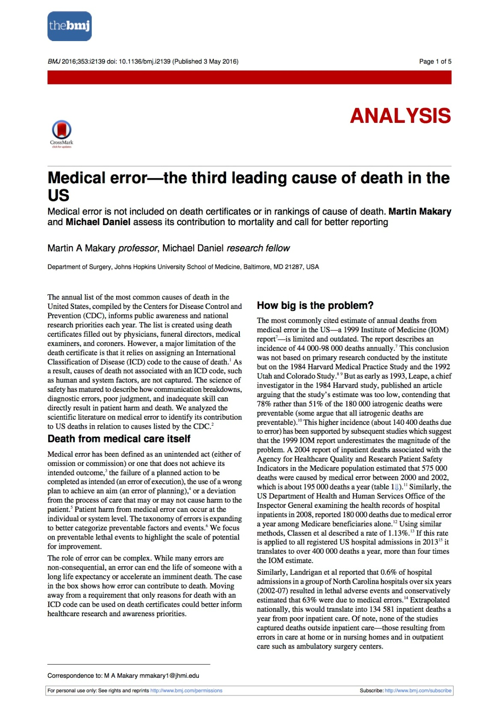
Preventable deaths: 44-400,000
Third leading cause death
Cardiac; cancer
Human error inevitable (presumption)
Medical error:
“an unintended act (omission or commission)
or one that does not achieve its intended outcome;
the failure of a planned action as intended (execution) ;
the use of a wrong plan to achieve an aim (planning) ;
or a deviation from the process of care”
Strategies to address errors
Readily available remedies (Rescue)
Make errors less frequent
Culture of safety
Make errors more visible when they occur (awareness)

Slide 24
RCI: Respiratory Compromise
“Respiratory compromise” is defined as a state in which there is a high likelihood of decompensation into respiratory failure or death, but in which specific interventions (enhanced monitoring and/or therapies) might prevent or mitigate decompensation.

Slide 25
OR NORA WARD

Slide 26
Respiratory Illness
ICU admission criteria
Mortality
Stable
respiratory illness
Respiratory Compromise
Respiratory Failure
Tim Morrison MD

Slide 27
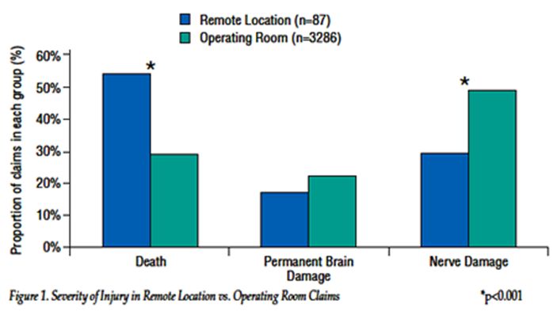
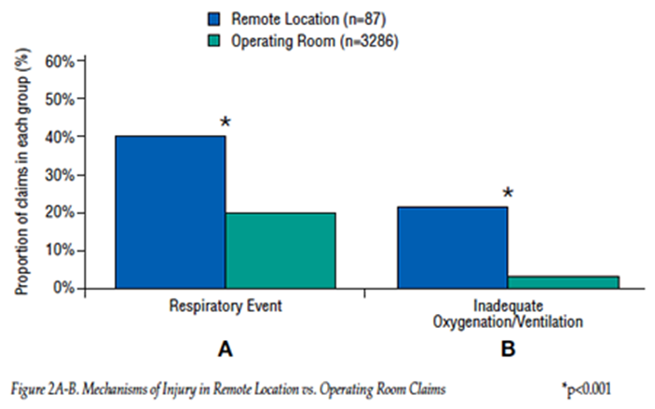
NORA Closed Claim Database
NORA vs. OR
Older ,sicker patients
Increased risk of death
54 vs 29%, P< 0.001
Higher risk of respiratory complications
44% vs 20%, P < 0.001
Inadequate oxygenation/ventilation
21% vs 3%, P < 0.001
Associated factors
Non-vigilance
Inappropriate anesthetic technique
Inappropriate (substandard) monitoring
Preventable by better monitoring
32% vs 8%, P<0.001
Metzner-APSF Spring 2011

Slide 28
Standards
3.2.1- Continual monitoring for expired CO₂ shall be performed
3.2.2- When an endotracheal tube or LMA is inserted it must be verified by carbon dioxide in expired gas
3.2.4- During moderate or deep sedation ventilation shall be evaluated by the presence of exhaled carbon dioxide.
Adapted from ASA Standards for Basic Anesthesia Monitoring. 2011
Also adopted by AAGBI in 2011

Slide 29
Opioid use is associated with adverse effects most importantly respiratory depression
16% of all adverse drug events (ADE) are related to opioids
29% are related to improper monitoring
Preventable morbidity and mortality
Effective Analgesia
Risk/ ADE

Slide 30
Causes of Opioid-Related Respiratory Depression
Lack of knowledge about potency differences among opioids
Improper prescribing administration of multiple opioids and modalities of opioid administration (i.e., oral, parenteral and transdermal patches)
Inadequate monitoring of patients on opioids
The Joint Commission
Sentinel Event Alert “Safe use of opioids in hospitals”
(Issue 49, August 8, 2012)

Slide 31
Health IT Configuration/Workflow
Pt ID Errors
Behavioral Health management
Disinfection Scopes
Test Reporting and follow up
Monitoring of Respiratory Depression on Opioids
Medication Errors related to size
Retained Objects Despite correct Count
Microbial Stewardship
Failure To Embrace a Culture of Safety#2
Information Management in EHR’s
Unrecognized Patient Deterioration
Implementation/Use Decision support systems
Test result reporting /follow up
Antimicrobial stewardship
Patient identification
Opioid administration and monitoring in acute care
Behavioral Health issues
Management New Oral Anticoagulants
Inadequate Organization Systems or Processes to Improve Patient safety and Quality

Slide 32
PCA: Respiratory Compromise
The Problem (#6 Vital Sign)
Over 13,000,000 patients receive PCA in US
0.16 to 5.2% suffer respiratory depression (est.)
Between 20,800 and 676,000 patients will experience opioid induced respiratory depression**
Robert Stoelting
Patient Safety Science and Technology Summit
January 2013
**Fecho K. Anesth 2008;109A34
370 Code blues @ academic center over 12months
Etiology-#1-30.3% respiratory depression often associated with opioid administration

Slide 33
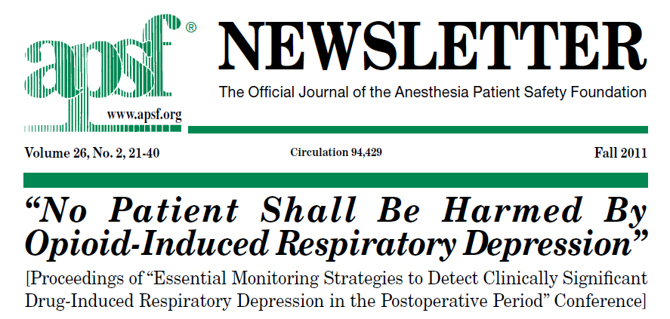

Slide 34
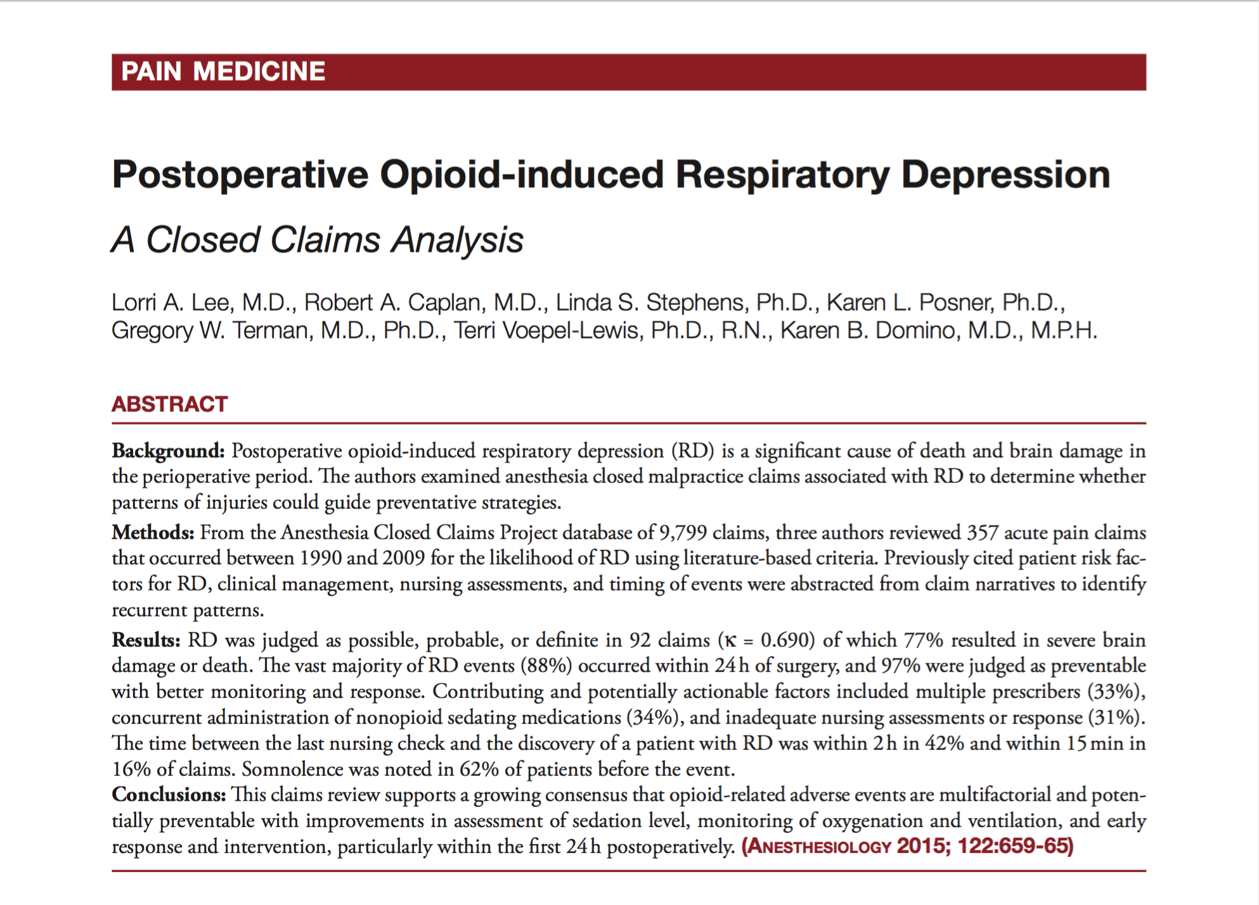
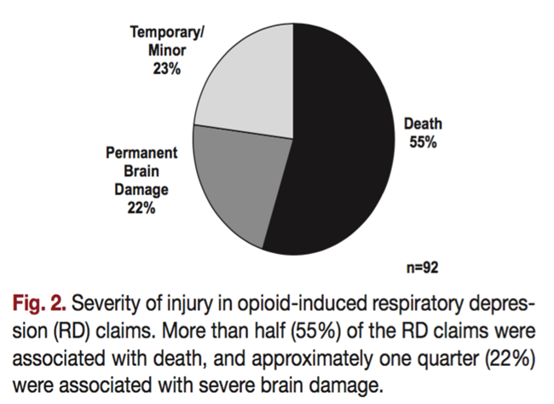
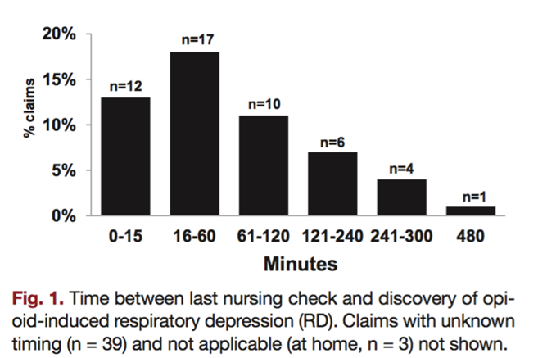
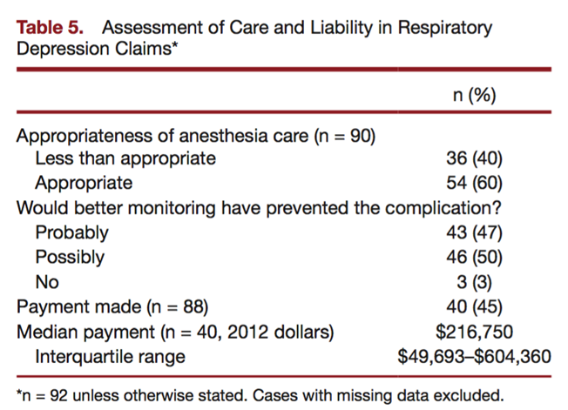
N=92
(357)
1990-2009
77% resulted in severe brain damage or death
Contributing factors
Multiple prescribers
Concurrent non-opioid sedating medications
Inadequate nursing assessment and response
Time between nursing check and respiratory event often w/in 2 hours
97% believed preventable with better monitoring
Conclusion(s): Opioid related adverse events are multifactorial; potentially preventable with better patient assessment/monitoring of sedation, oxygenation and ventilation and early response.

Slide 35
Risk Factors
Opioid Induced Respiratory Depression
Obesity
Low Body Weight
Concomitant medications that potentiate opioids
Pre existing conditions
Asthma, COPD, OSA
Advanced age
Opioid Naive

Slide 36
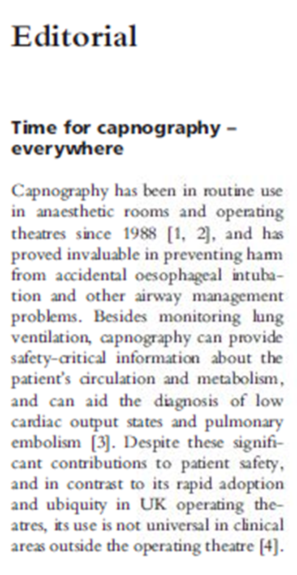
Clinical Applications of Capnography
Intra-Operative Anesthesia
Non Operating Room Anesthesia (NORA)
Procedural Sedation
PACU
ER
Transportation of intubated patients
Hypoventilation monitoring on wards for patients
at risk of respiratory compromise
COPD, OSA, narcotic administration
ACLS
ICU
Whitaker, D.K. Anaesthesia 2011

Slide 37
Type 2: Classic CO₂ Narcosis
Lynn, et al. Patient Safety in Surgery. 2011

Slide 38
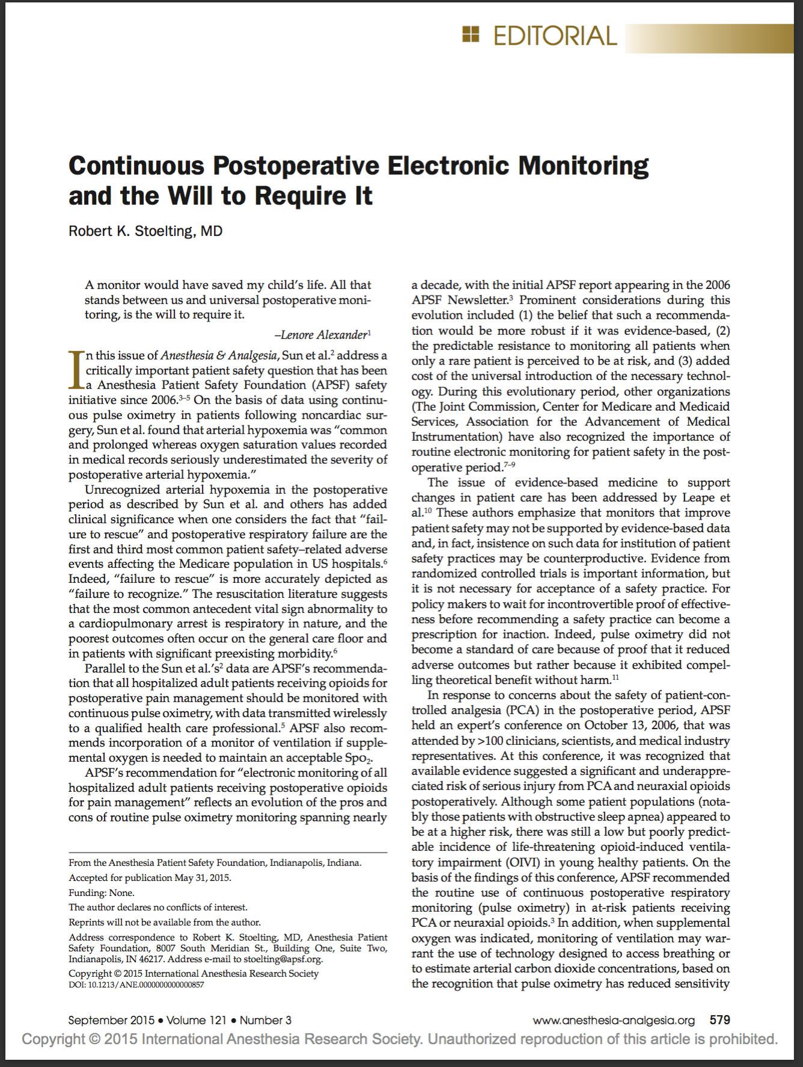
Patient safety (Medicare adverse events in hospital)*
#1 failure to rescue (vs. failure to recognize)
#3postoperative respiratory failure
“insistence on such data (EBM) for the institution of patient safety practices may be counterproductive” (e.g. pulse oximetry)
Postoperative hypoxemic events underestimated*
Earlier detection reduces need for rescue**
APSF recommendations
All hospitalized adults receiving opioids for postoperative pain be monitored with continuous pulse ox and data transmitted to care giver
Confirmation of the “need” for supplemental O2
If supplemental O2 used incorporation of ventilation monitor to assess breathing or estimate arterial CO2 may be warranted
*Sun Z Anesth Analg 2015;121:709-15;**Taenzer AH Anesth Analg 2014;118:326-31
Taenzer AH Anesthy 2010;112:282-7

Slide 39
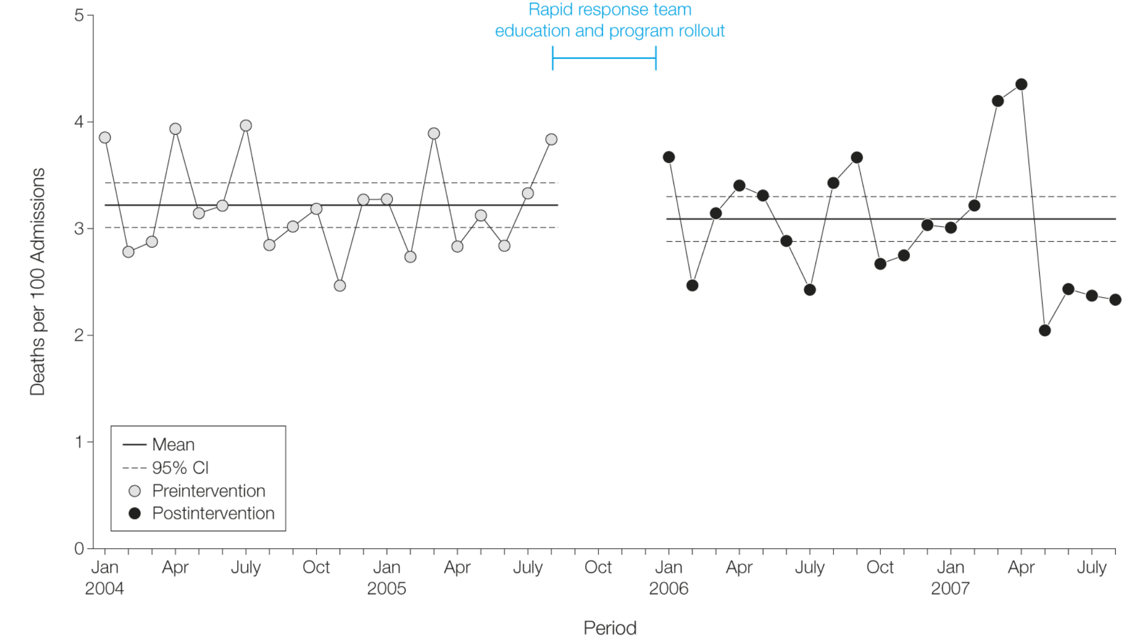
RRTs may not change mortality rates
Failure to rescue…
or Failure to recognize???
Chan, et al. Hospital-wide code rates and mortality before and after implementation of a rapid response team. Journal/JAMA : the journal of the American Medical Association. 2008. 300(21)2506-2513
Revised from Timothy Morris
Notes:
The preintervention period was between January 1, 2004, and August 31, 2005, and the postintervention period was between January 1, 2006, and August 31, 2007. CI indicates confidence interval.

Slide 41
Afferent Limb Failure: 96% of patients who met MET criteria did not activate system

Slide 43
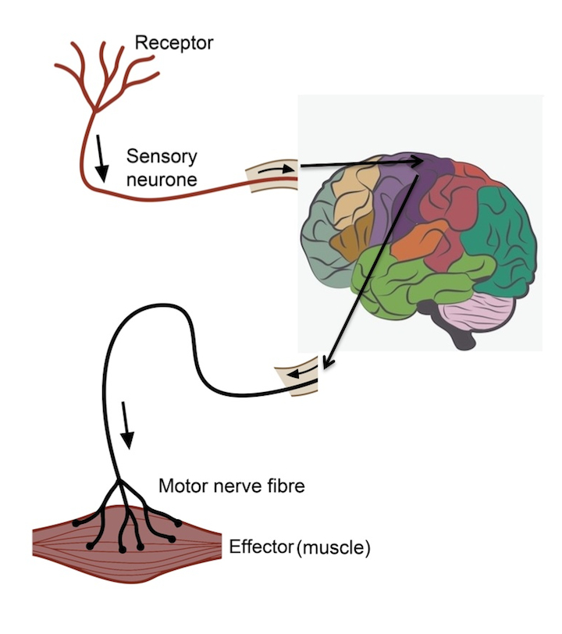
The Opportunity
Afferent Limb Failure
Algorithms to reduce alarm and allow timely activation
Algorithms to assist in identification and integration of the data
Monitoring the appropriate signals for respiratory compromise
Are we monitoring correct parameters?

Slide 44
Respiratory Compromise Institute
Future Research Considerations - Medical
Neil MacIntyre, MD

Slide 45
Respiratory Compromise Institute Future Research Considerations - Medical
Focus on “unplanned” intubations in the medical patient
Identifying risk factors
Identifying and developing strategies for detection/prevention

Slide 46
Respiratory Compromise Institute Future Research Considerations - Medical
Focus on “unplanned” intubations in the medical patient
Diseases at risk
Trajectories of deterioration
Identifying risk factors
Identifying and developing strategies for detection/prevention

Slide 47
Disease states at risk
Neurologic – impairment of control of breathing
Cardiovascular – impairment of perfusion
Respiratory – impairment of ventilation, V/Q matching
Systemic inflammation – impairment of O2 uptake
Co-morbidities (diabetes, immunosuppression, renal) complicate the situation

Slide 48
Trajectories of deterioration
Sudden, unexpected, catastrophic
Neurologic disaster
Cardiovascular collapse (MI)
Respiratory event (aspirations, emboli, pneumothorax, bronchospasm)
Gradual deterioration
Neurologic (drugs)
Cardiovascular (fluid overload, drugs)
Respiratory (infection, sepsis, ARDS)

Slide 49
Respiratory Compromise Institute Future Research Considerations - Medical
Focus on “unplanned” intubations in the medical patient
Diseases at risk
Trajectories of deterioration
Identifying risk factors
Identifying and developing strategies for detection/prevention

Slide 50
Exploring EMRs of health systems
End point is unplanned intubations (intubations > 24 hrs post admission or surgery)
What are the high risk medical conditions?
What are the events in the 12 hours before the intubation?
What is the impact of hospital size, location?

Slide 51
Respiratory Compromise Institute Future Research Considerations - Medical
Focus on “unplanned” intubations in the medical patient
Diseases at risk
Trajectories of deterioration
Identifying risk factors
Exploring EMRs of health systems – multiple hospitals/environments
Prospective validations of risk scores (SOFA equivalents)
Identifying and developing strategies for detection/prevention

Slide 52
Respiratory Compromise Institute Future Research Considerations - Medical
Focus on “unplanned” intubations in the medical patient
Diseases at risk
Trajectories of deterioration
Identifying risk factors
Exploring EMRs of health systems – multiple hospitals/environments
Prospective validations of risk scores (SOFA equivalents)
Identifying and developing strategies for detection/prevention
Evaluate monitoring tools
Evaluating risk adjusted monitoring strategies

